Slide 1
Strengthening
Hydro-Meteorological and Early Warning Services in the Caribbean
CREWS 5th Steering Committee Meeting
Bonn, 8 November 2017

Slide 2
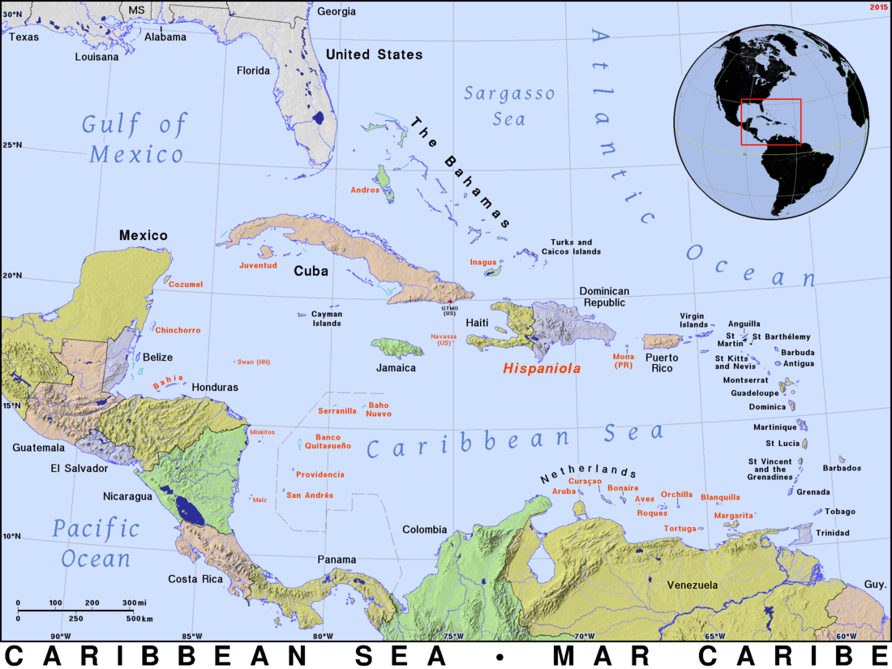
CREWS contribution: US$ 5.5 million
Main objective: To strengthen and streamline regional and national systems and capacity related to weather forecasting, hydrological services, multi-hazard impact-based warnings and service delivery for enhanced decision- making.
Implementing Partners: WB/GFDRR, WMO & UNISDR
Regional IPs: Caribbean Institute for Meteorology and Hydrology (CIMH)
Caribbean Disaster Emergency Managmt. Agency (CDEMA)
Other partners: Association of Caribbean States (ACS), Caribbean Community
Climate Change Centre (CCCCC), Royal Netherlands
Meteorological Institute (KNMI), MétéoFrance, International
Federation of Red Cross and Red Crescent Societies (IFRC) and
International Telecommunication Union (ITU)
Further key stakeholders: National Meteorological and Hydrological Services & Disaster Risk
Management Agencies

Slide 3
Component 1
Development of regional strategy to strengthen and streamline early warning and hydromet services
Assessment of status of Hydromet and EWS services;
Development of a strategy for strengthening institutional alignment & coordination incl. conceptualization of a regional “cascade”;
Develop an appropriate approach to risk informed decision making;
Assessment of socio-economic benefits of better hydromet services & EWS for advocacy at high levels; and
Identification of priority investment needs and development of investment proposals for leveraging further funding.

Slide 4
Component 2
Institutional Strengthening and streamlining of early warning and hydromet services
Capacity building and training activities focusing on further strengthening of a WMO cascading forecasting system, flash flood guidance, etc.
Institutional strengthening at regional and national level to support a clear definition of roles and responsibilities;
Strengthening hydromet observation, data management systems and weather, climate and flood forecasting;
Improve utilization of Doppler radar info;
Introduction of Multi-hazard EWS and Impact-based forecasting;
Awareness raising with multiple actors on early warning as integrated element of disaster risk management; and
Awareness raising and capacity building for priority sector users.

Slide 5
Component 3
Support for piloting high priority national activities including impact-based forecasting
This component will support piloting and implementation of high priority activities on the national level. The specific scope will be discussed with the regional organizations and potential beneficiary countries which would be also guided by the process of developing regional strategy and investment plan to be undertaken in the activity.

