Slide 1
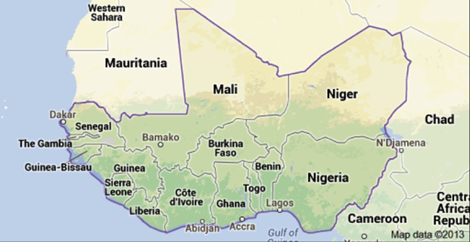
CREWS West Africa Regional Work Plan
UPDATE FOR THE CREWS STEERING COMMITTEE
6 September 2017

Slide 2
Outline
CREWS, and other, projects in west Africa
CREWS west Africa regional work plan
Process, and next steps, for finalization

Slide 3
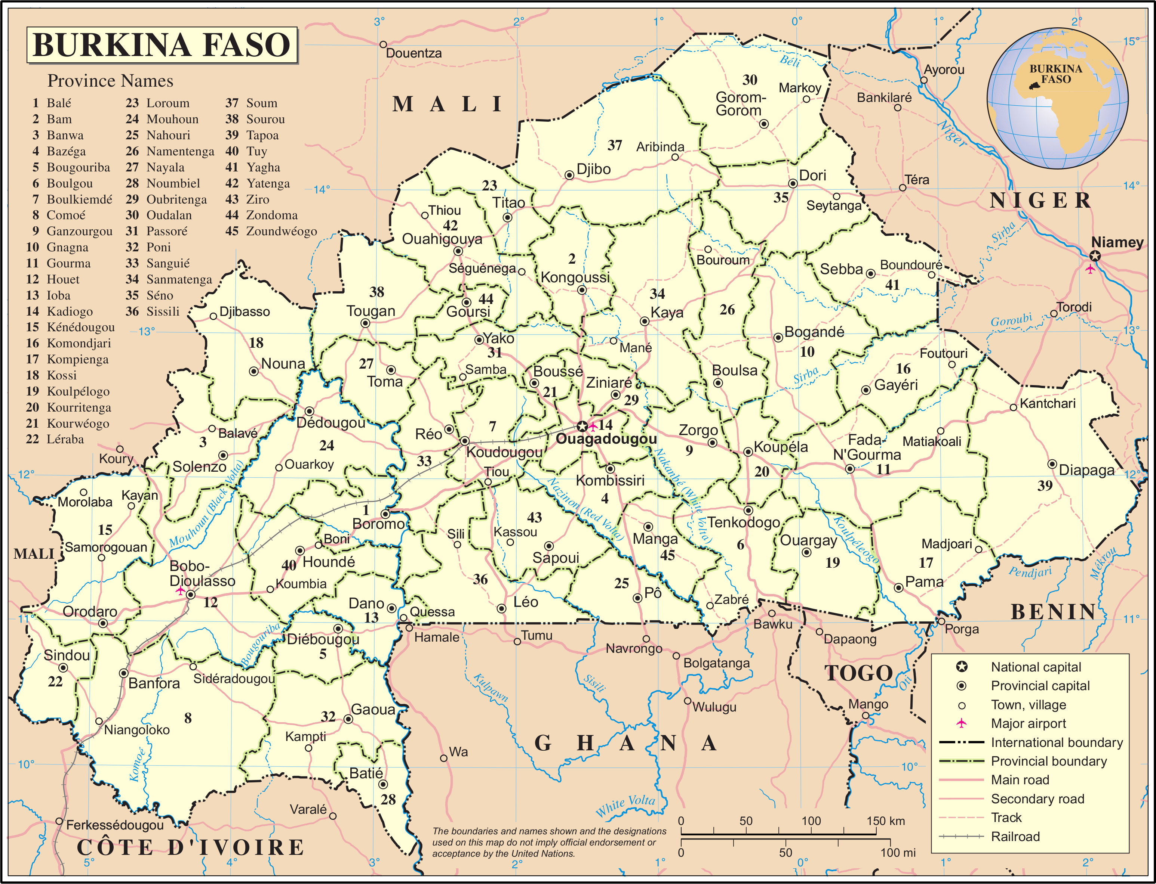
Component A: Basic systems. observations, databases, numerical forecasts, monitoring and analysis
Assessment of observation network processes and needs
Data base improvement
Short term forecast capabilities for severe weather and flood early warning
Seasonal to sub-seasonal forecasts for early warning to farmers and the agriculture sector
Analysis and nowcasting tools
Burkina Faso
Component B: Early warning system development. Weather and climate information translated into EW alerts and agriculture advisories in an understandable format co-produced with the user stakeholders
Risk information and forecast products for severe weather and flood early warning
Risk information and forecast products for agriculture and food security
Component C: Institutional strengthening.
Long term development plan for DGM
Component D: Management.
Notes:
CREWS resources will contribute to improvement of Government of Niger’s early warning services by:
Enhancing food security early warning system
Establishing a flood and extreme weather warnings (mostly in urban areas and along major Niger and Komadougou Rivers)

Slide 4
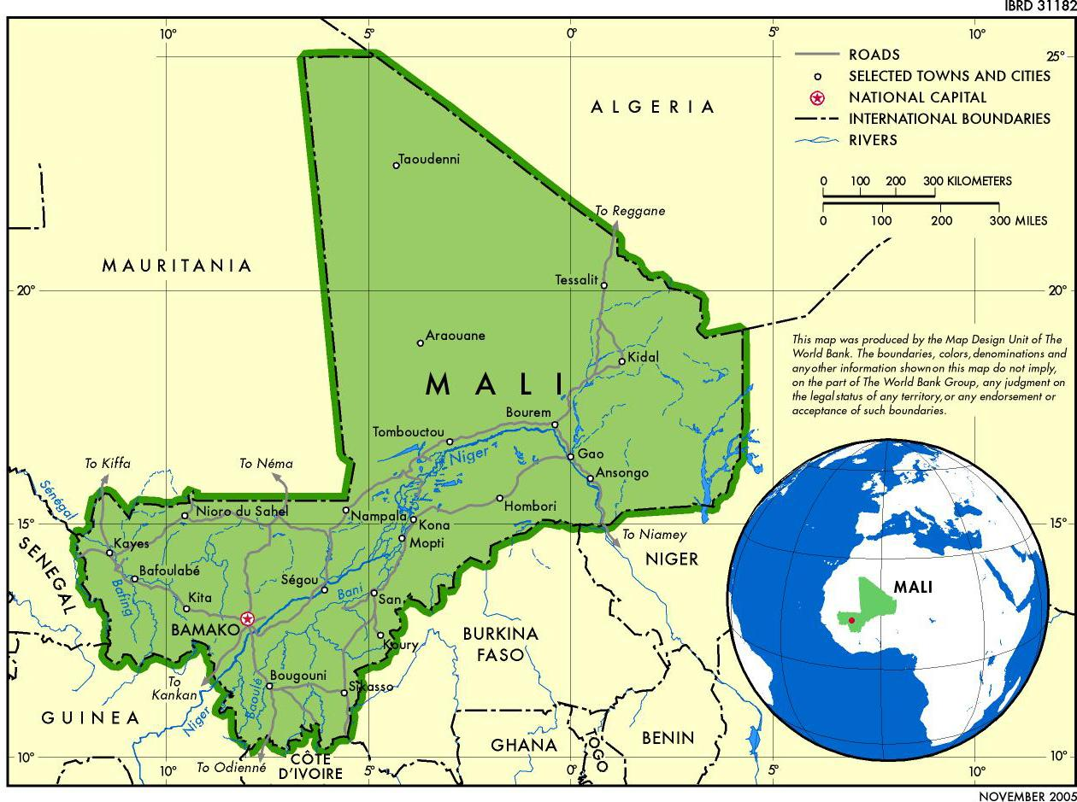
Component A. Strengthening institutional, partnerships and regulatory frameworks and technical capacity building
Strengthening the institutional and regulatory framework for hydrometeorological and warning services: a) Operational procedures for rapid warning and response, b) Protocols for information exchange among institutions, c) Strengthening of tools for the collection, management, archiving, analysis and sharing of information;
Capacity building and staff training (including operational training).
MALI
Component B. Provision of basic warning support services in accordance with the National Framework for Climate Services
Development of flood and drought forecasting and warning services for specific institutional users
Provision of public services (information and warnings): (i) bidirectional communication and (ii) feedback mechanisms
Strengthen citizen engagement and monitoring of end-user satisfaction, based on needs surveys and mechanisms for user feedback on services
Community training and simulations on product use and capacity building, with a gender approach

Slide 5
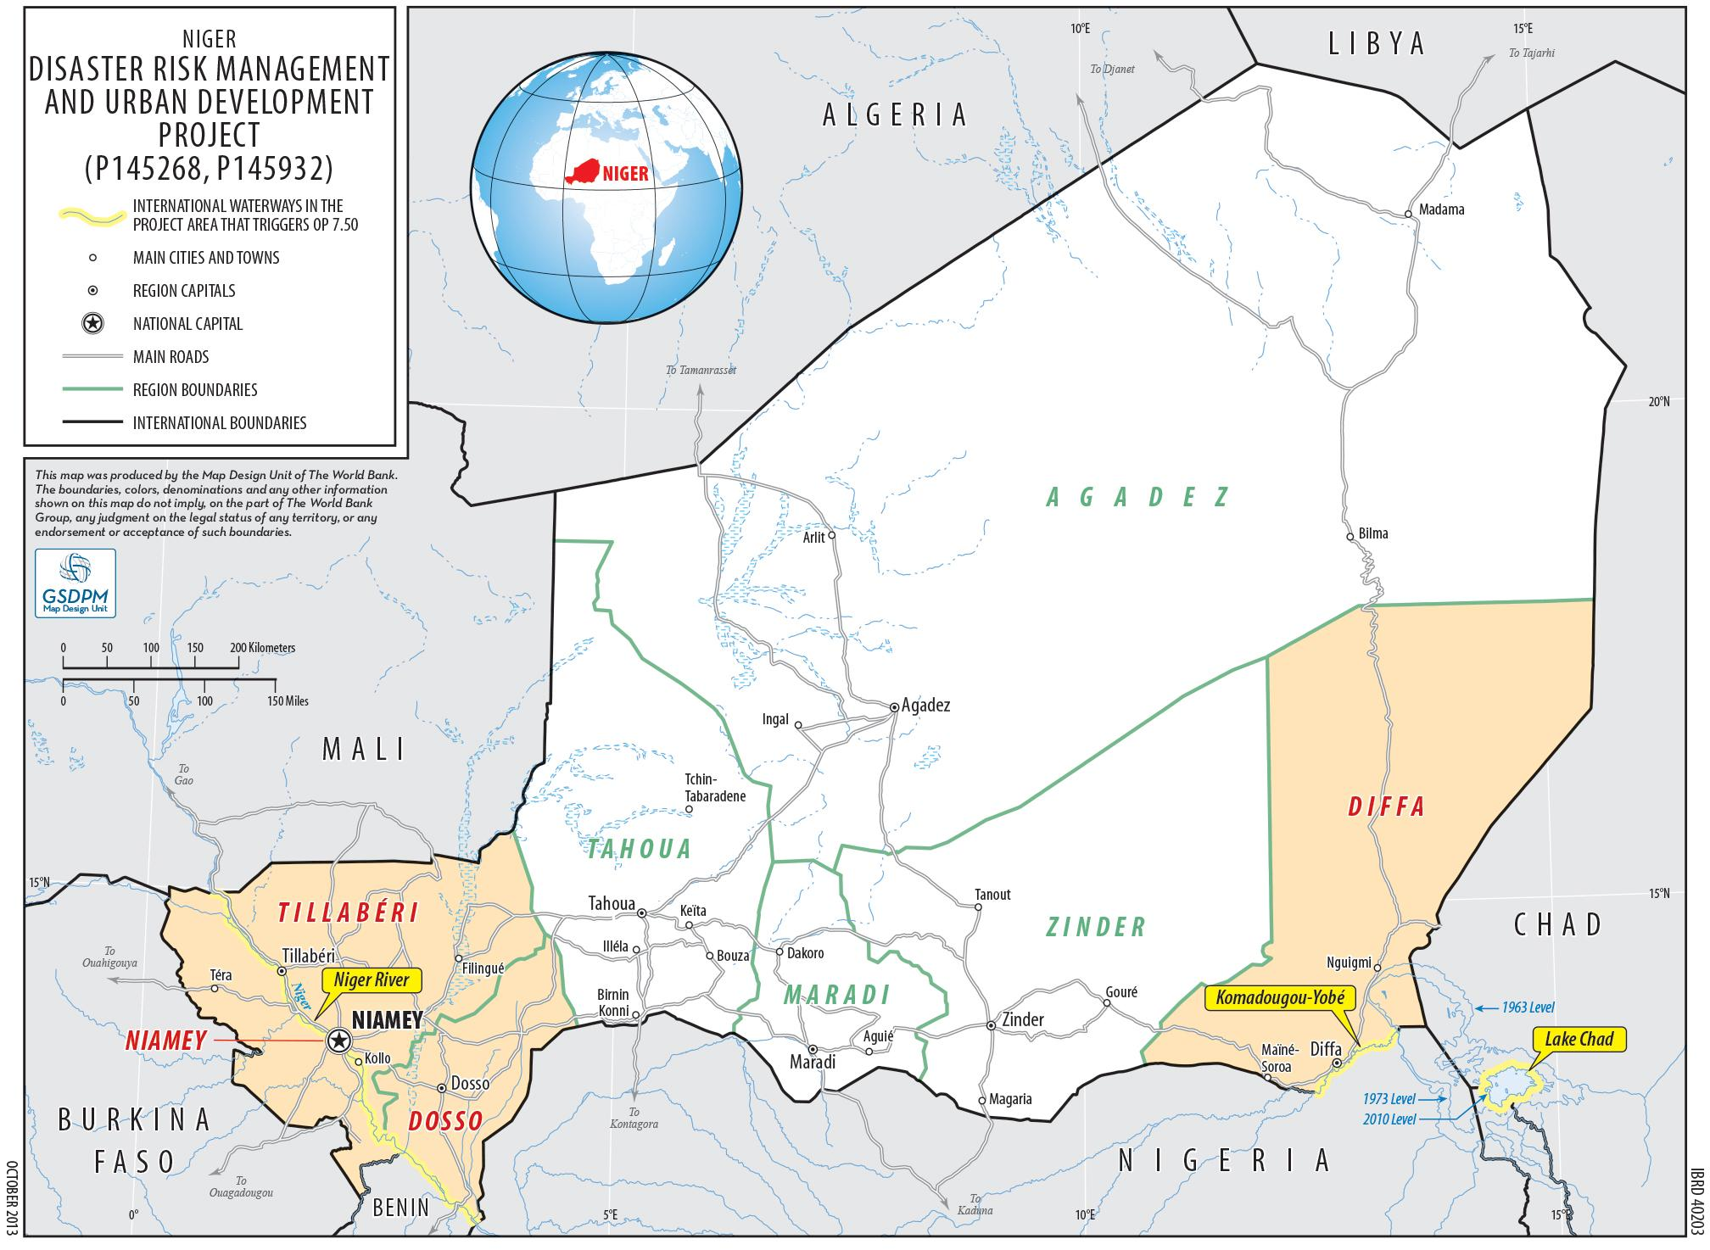
Component A. Strengthening institutional, partnerships and regulatory frameworks and technical capacity building
Strengthening the institutional and regulatory framework for hydrometeorological and warning services: a) Operational procedures for rapid warning and response, b) Protocols for information exchange among institutions, c) Strengthening of tools for the collection, management, archiving, analysis and sharing of information;
Capacity building and staff training (including operational training).
NIGER
Component B. Provision of basic warning support services in accordance with the National Framework for Climate Services
Identification of requirements of decision-makers and the population at risk for warning of extreme events (rainfall, flooding, storms and sandstorms, bush fires, heat waves, etc.);
Design, production, dissemination of warning services and accurate and relevant information bulletins (forecasting, monitoring, risk assessments and other analytical products);
Support for the coordination of the emergency response (contingency plans, ORSEC emergency response plans, PCS municipal safeguard plans) including community training
Strengthen citizen engagement and monitoring of end-user satisfaction, based on needs surveys and mechanisms for user feedback on services
Notes:
CREWS resources will contribute to improvement of Government of Niger’s early warning services by:
Enhancing food security early warning system
Establishing a flood and extreme weather warnings (mostly in urban areas and along major Niger and Komadougou Rivers)

Slide 6
Programme alignment
Niger, Mali and Burkina have substantial World Bank investment projects under implementation, approved or in preparation and these can be adjusted to some degree to both support and benefit from the CREWS funded activities
GFCS/WMO is preparing a major regional GCF project for the Sahel that is coordinated with, and can build on the CREWS-supported work

Slide 7
CREWS west Africa regional work plan

Slide 8
Value-added
Create a cascading (circulating) operational system supporting the CREWS west Africa country projects
data and requirements coming up from the countries (principally severe weather, flood and agriculture EW related) to regional and global centers
forecast and other outputs coming back to countries from regional/global centers for downscaling, tailoring and service delivery

Slide 9
Benefits
EWS improvements from strengthened exchange of data and model outputs between the NMHSs and up to three regional centers (ACMAD, AGRHYMET and RSMC Dakar), with international support
Identification of needs and next steps for further improvements with additional resources
CREWS west Africa work plan working budget currently at ~$2.33m↑, against $1.5m allocated

Slide 10
Work plan components
Databases
Historical climate, for risk assessment and forecast verification
Extreme events
Observing systems
Leveraging ongoing investments by bringing stations sustainably online per WMO standards
Monitoring
Climate Watch
Forecasts
Severe weather, floods, sub-seasonal, seasonal
Communication, capacity development and system integration among national and regional entities

Slide 11
Process, and next steps, for finalization

Slide 12
Completed
Inventory and analysis of related programmes
Review of needs assessments and current status of operational systems
Draft work plan and budget, with input from
Meteorological services of the Netherlands (KNMI) and Germany (DWD) plus Meteo France (Burkina Faso work plan implementing partner)
All relevant WMO departments
GFDRR

Slide 13
Pending
Further review of additional materials and prioritization of deliverables
Finalization of regional partners for operationalization of specific system components (RSMC Dakar, AGRHYMET and ACMAD) and circulation to partners for final inputs
Final revisions for Steering Committee approval

Slide 14
Thank you

