Slide 1
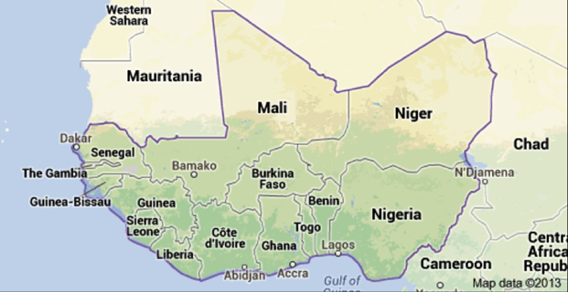
West Africa Regional Work Plan Example
CREWS PANEL DISCUSSION AT COP23
10 November 2017

Slide 2
Outline
CREWS, and other, projects in west Africa
CREWS west Africa regional work plan

Slide 3
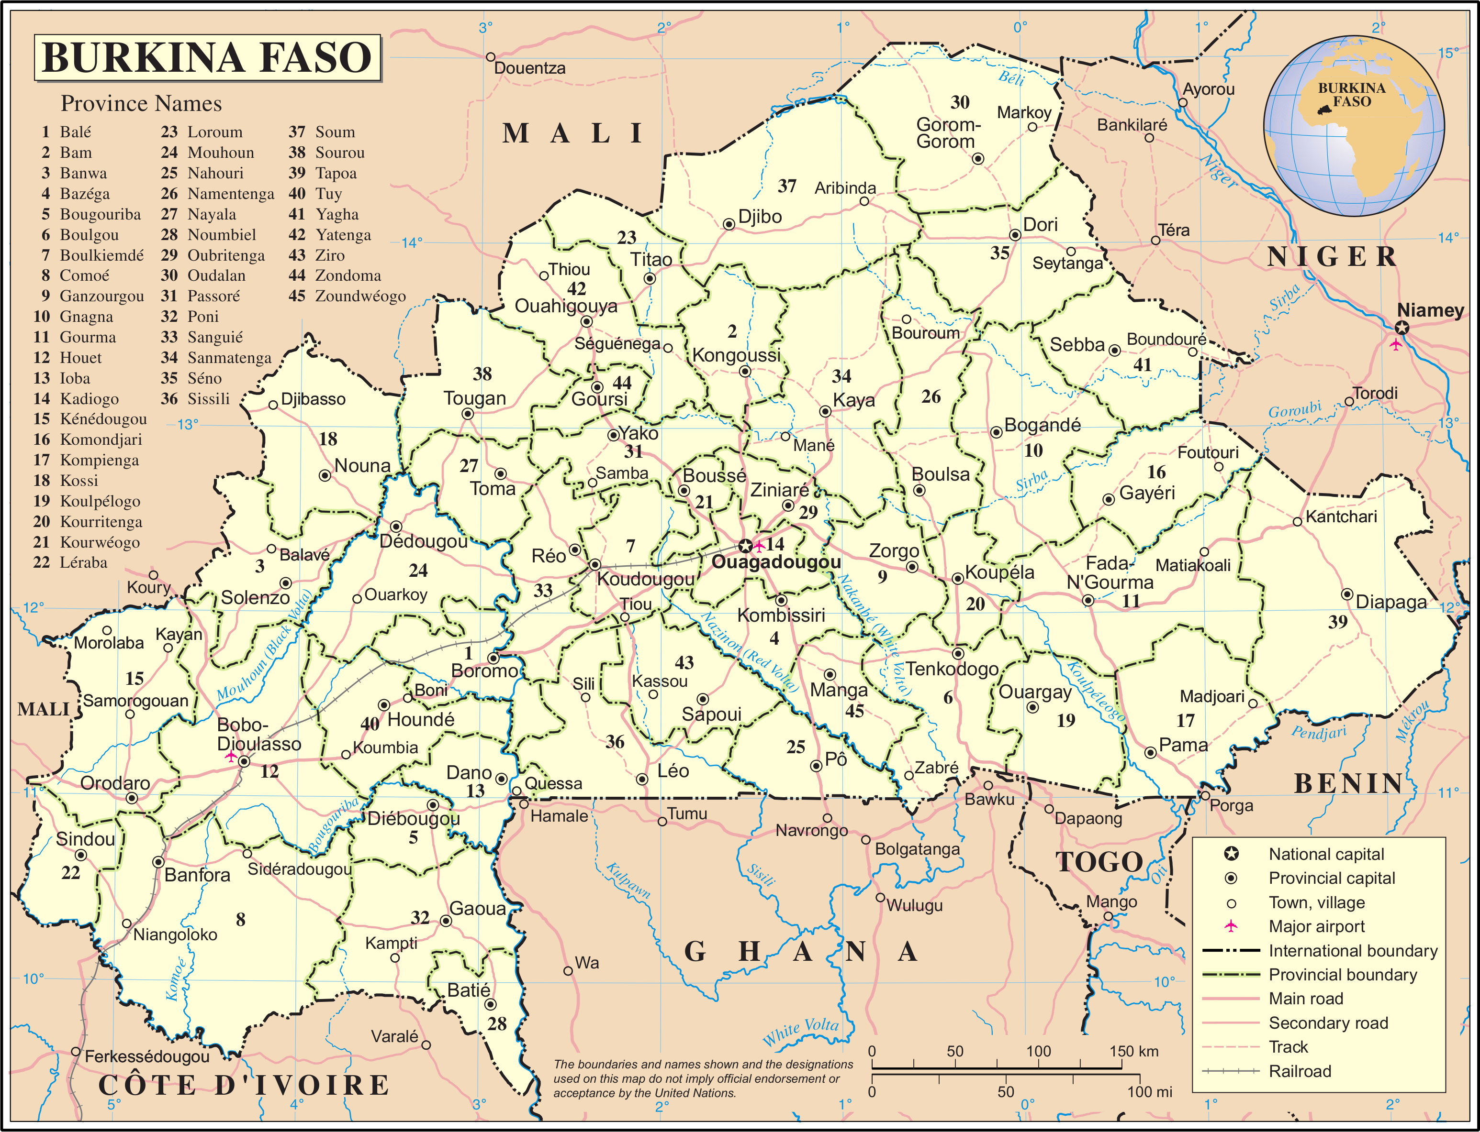
Component A: Basic systems. observations, databases, numerical forecasts, monitoring and analysis
Assessment of observation network processes and needs
Data base improvement
Short term forecast capabilities for severe weather and flood early warning
Seasonal to sub-seasonal forecasts for early warning to farmers and the agriculture sector
Analysis and nowcasting tools
Burkina Faso
Component B: Early warning system development. Weather and climate information translated into EW alerts and agriculture advisories in an understandable format co-produced with the user stakeholders
Risk information and forecast products for severe weather and flood early warning
Risk information and forecast products for agriculture and food security
Component C: Institutional strengthening.
Long term development plan for DGM
Component D: Management.
Notes:
CREWS resources will contribute to improvement of Government of Niger’s early warning services by:
Enhancing food security early warning system
Establishing a flood and extreme weather warnings (mostly in urban areas and along major Niger and Komadougou Rivers)

Slide 4
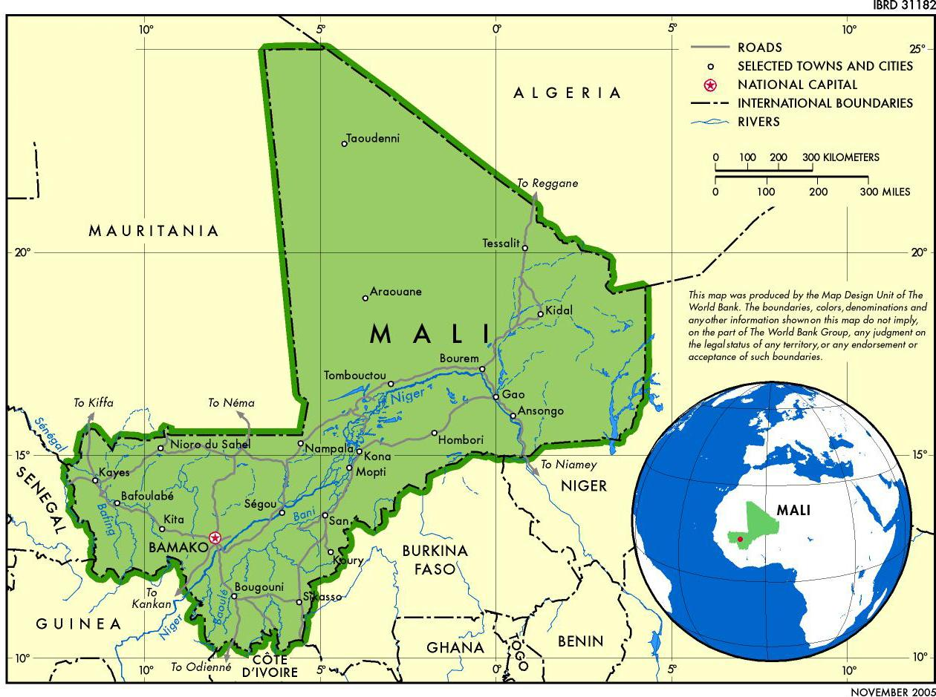
Component A. Strengthening institutional, partnerships and regulatory frameworks and technical capacity building
Strengthening the institutional and regulatory framework for hydrometeorological and warning services: a) Operational procedures for rapid warning and response, b) Protocols for information exchange among institutions, c) Strengthening of tools for the collection, management, archiving, analysis and sharing of information;
Capacity building and staff training (including operational training).
MALI
Component B. Provision of basic warning support services in accordance with the National Framework for Climate Services
Development of flood and drought forecasting and warning services for specific institutional users
Provision of public services (information and warnings): (i) bidirectional communication and (ii) feedback mechanisms
Strengthen citizen engagement and monitoring of end-user satisfaction, based on needs surveys and mechanisms for user feedback on services
Community training and simulations on product use and capacity building, with a gender approach

Slide 5
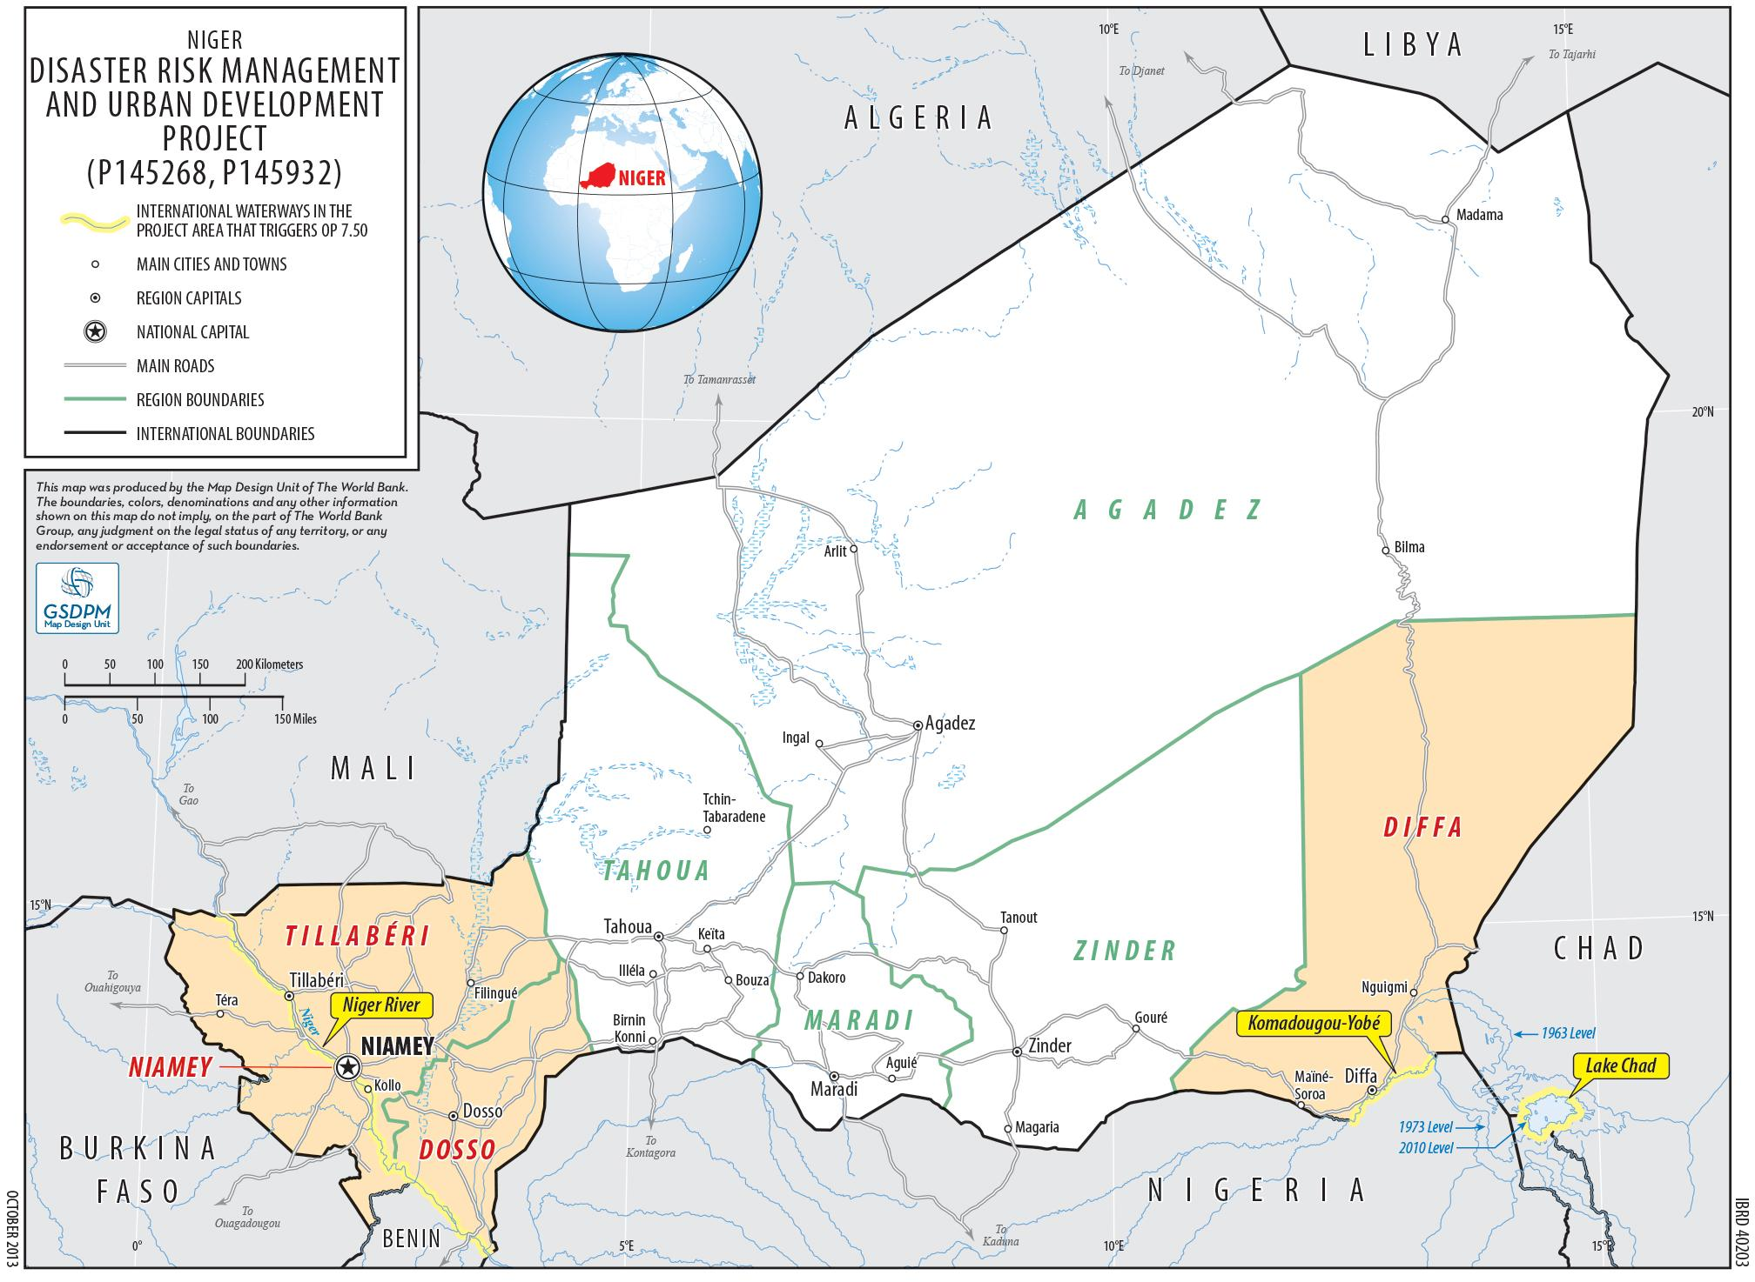
Component A. Strengthening institutional, partnerships and regulatory frameworks and technical capacity building
Strengthening the institutional and regulatory framework for hydrometeorological and warning services: a) Operational procedures for rapid warning and response, b) Protocols for information exchange among institutions, c) Strengthening of tools for the collection, management, archiving, analysis and sharing of information;
Capacity building and staff training (including operational training).
NIGER
Component B. Provision of basic warning support services in accordance with the National Framework for Climate Services
Identification of requirements of decision-makers and the population at risk for warning of extreme events (rainfall, flooding, storms and sandstorms, bush fires, heat waves, etc.);
Design, production, dissemination of warning services and accurate and relevant information bulletins (forecasting, monitoring, risk assessments and other analytical products);
Support for the coordination of the emergency response (contingency plans, ORSEC emergency response plans, PCS municipal safeguard plans) including community training
Strengthen citizen engagement and monitoring of end-user satisfaction, based on needs surveys and mechanisms for user feedback on services
Notes:
CREWS resources will contribute to improvement of Government of Niger’s early warning services by:
Enhancing food security early warning system
Establishing a flood and extreme weather warnings (mostly in urban areas and along major Niger and Komadougou Rivers)

Slide 6
CREWS West Africa work plan
Project title: Seamless operational forecast systems and technical assistance for capacity building in west Africa
Cost: USD 1.835m
Duration: 2018-2020 (three years)
Main implementing partners: WMO and KNMI, DWD, Hydrologic Research Centre (HRC), University of Reading, International Research Institute for Climate and Society (IRI), with ACMAD, AGRHYMET, RSMC Dakar and participating country NMHSs

Slide 7
Objective: An operational severe weather, flood and climate forecast system, underpinned by on-going observations and continuously updated historical data, that provides monitoring and forecast outputs and products, as well as related knowledge, in support of CREWS-related activities in Burkina Faso, Mali, Niger, and other countries in the region, through enhanced capacity by regional centers to support national level provision of risk information and end-to-end early warning services.

Slide 8
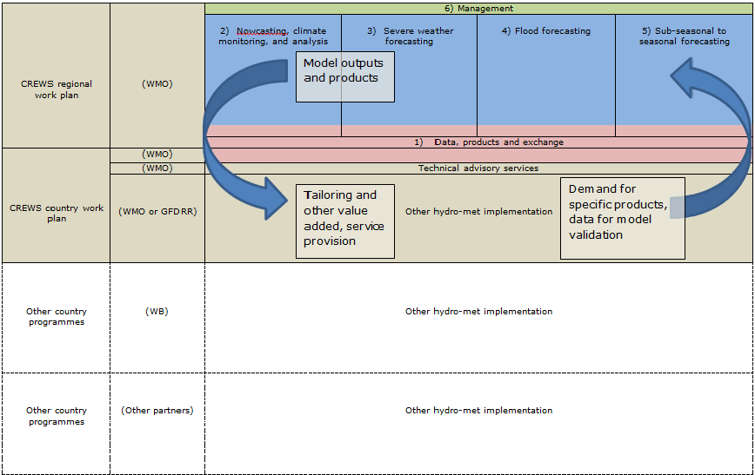
Components In context of CREWS and other relevant country programmes

Slide 9
Thank you

