Slide 1
Status review of early warning systems in LDCs and SIDS
CREWS Steering Committee, 12 September 2016, WMO, Geneva, Switzerland
CREWS/SC.1/Infdoc.4

Slide 2
Objective
Guide early warning systems investment - both national and ODA
Strengthen systems and capacity for SIDS and LDCs to measure their systems effectiveness and prioritize their investments – building on body of knowledge showing cost-return of investements in early warning systems
April 2016 WMO/GFDRR development partners roundtable on strengthening hydrometeorological services
“…partners should measure and share the impacts of coordination and investments.”
“Investments should be made against a constantly updated and transparent long-term planning process…”
Good practices are the “Adoption of National Strategic Plans for the modernization of NMHSs…” and the “…development, promotion and widespread usage of the WMO’s Country Profile Database”.
Monitor early warning effectiveness
Support countries measure the effectiveness of their early warning system against Sendai Framework, 2030 Sustainable Development Agenda and Paris Climate Change Agreements
Work of the Open-Ended Working Group on DRR and Target G
Steering Committee Meeting 12 September 2016 WMO, Geneva, Switzerland
Notes:
The reason we are focusing on mapping status of EW are twofold first
If you can’t measure – you don’t do… increasing priorities
Appetite for accountability on their efforts towards sustainable development
In particular the work of the OEIWG on indicators for disaster risk reduction

Slide 3
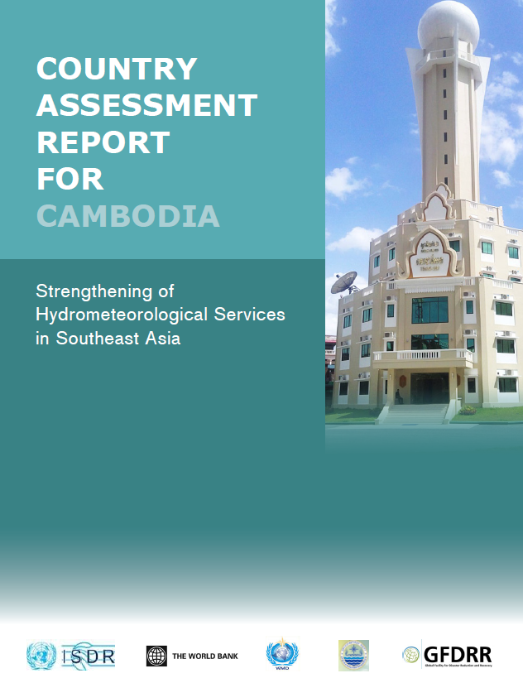
Existing Assessments of Early Warning Systems and Related Capacity
Country reports and analysis (2009, 2011, 2013, 2015) on progress against the Hyogo Framework for Action 2005-2015 – measured against four components of EWS
United Nations Secretary-General ‘Global survey of early warning systems - An assessment of capacities, gaps and opportunities towards building a comprehensive global early warning system for all natural hazards’ (UN, 2007)
WMO Global Review of NMHSs’ capacities for DRR (2006, update planned for Q4 2015)
UNEP (2012). Early Warning Systems: A State of the Art Analysis and Future Directions.
World Bank, WMO and UNISDR regional and country assessment capacity of the NHMSs for Central and Southeast Europe and Southeast Asia (financed through GFDRR / European Commission DG Enlargement, through its Instrument for Pre-Accession Assistance (IPA))
Review of gaps and needs in EWS for urban settings based on resilient city initiative scorecards (over 2000 cities engaged, 600 reporting)
WMO 2014. Synthesis of the Status and Trends with the Development of Early Warning Systems. Background Paper prepared for GAR 2015
Publication ‘Valuing Weather and Climate: Economic Assessment of Meteorological and Hydrological Services’ (WMO, no 1153, May 2015)
Notes:
No standard approach
Same methodology looks at capacities and gaps across the four elements of an effective early warning system
And I need to add here the recent review of EWS in the Pacific done by Australia and shared with this group

Slide 4
Mapping capacity status and needs
Continuous mapping of LDCs and SIDS as the basis for identifying Project Countries for CREWS allocations and Pipeline Countries, for future allocations
- Capacity
- Projected average annual loss
- Casualty loss risk
- Access to information and communication
- Potential to leverage investments
- Ongoing or planned national and regional programmes
- Requests for support by country
- Identification of early warning systems as a priority
Level of priority given to early warning systems by countries
Exposure to risk and institutional capacity for early warning
Potential for leveraging additional resources and aligning programmes
Notes:
To initiate the investment plan – carry out a rapid mapping of early warning systems

Slide 5
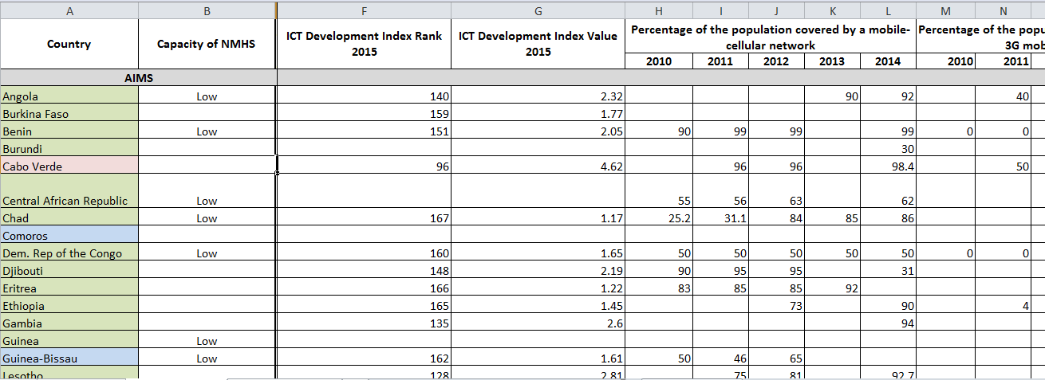
Mapping to guide CREWS Investment Plan
Steering Committee Meeting 12 September 2016 WMO, Geneva, Switzerland

Slide 6
Next steps
Support SIDS and LDCs monitor their early warning effectiveness – capacity and systems
Produce short annual status reports on climate information and early warning systems in LDCs and SIDS
Contribute the development of standard guidelines for measuring early warning effectiveness and global reviews
Align with work of Open Ended Working Group on Indicators for Disaster Risk Reduction
Build on WMO’s Country Profile Database
The International Conference on Early Warning System (tent. 22-23 May 2017 Cancun, Mexico) to adopt guidelines
Partner with other investment mechanisms Green Climate Fund (GCF), Global Environment Facility (GEF) … and others
Steering Committee Meeting 12 September 2016 WMO, Geneva, Switzerland
Notes:
Objective is to systematize and strengthen this approach to support the work of the Steering Committee but also to contribute to better alignment of other investment flows.

Slide 7
Thank You

